Slide 1
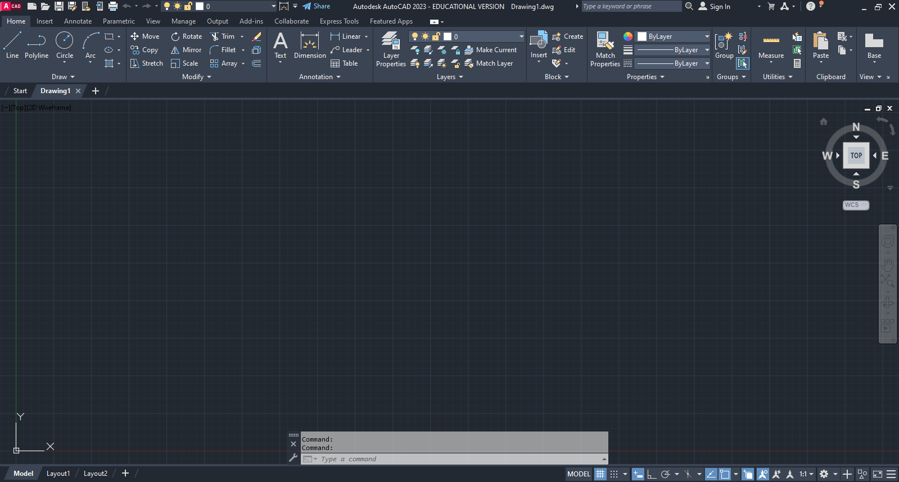
Unit 6 AutoCAD
Notes:
This Powerpoint is a collection of links to video instruction for AutoCAD basics. The videos are based off information from the textbook Up & Running with AutoCAD by Elliot Gindis and Robert Kaebisch, which is why there are references to sections or portions of information from the book. Pause the video periodically to practice the content that was covered. Use the COMMON HOTKEYS.pdf as a cheat sheet for becoming familiar with the common commands.

Slide 2
AutoCAD Overview
https://mediaspace.minnstate.edu/media/CTE+AutoCAD+Overview/1_rjxnkrdl
Learning Outcomes:
Open AutoCAD
User Interface
Notes:
https://mediaspace.minnstate.edu/media/CTE+AutoCAD+Overview/1_rjxnkrdl

Slide 3
Working in AutoCAD
https://mediaspace.minnstate.edu/media/CTE+Working+in+AutoCAD/1_hyj4iuur
Learning Outcomes:
Use the Command Line
Use the Ribbon

Slide 4
Working with create object commands
https://mediaspace.minnstate.edu/media/CTE+Working+with+create+object+commands/1_ohy6sdjv
Learning Outcomes:
Line
Circle
Arc
Rectangle
Notes:
Tic tack toe game

Slide 5
Navigating in AutoCAD
https://mediaspace.minnstate.edu/media/CTE+Navigating+in+AutoCAD/1_6ce5p66y
Learning Outcomes:
Zoom
Pan
Regen
Additional tips

Slide 6
Working with the Edit/Modify objects commands Part 1
https://mediaspace.minnstate.edu/media/CTE+Part+1+Working+with+the+Edit+Modify+objects+commands/1_q2qp9hfj
Learning Outcomes:
Erase
Move
Copy

Slide 7
Working with the Edit/Modify objects commands Part 2
https://mediaspace.minnstate.edu/media/CTE+Part+2+Working+with+the+Edit+Modify+objects+commands/1_5q7odbbo
Learning Outcomes:
Rotate
Scale

Slide 8
Working with the Edit/Modify objects commands Part 3
https://mediaspace.minnstate.edu/media/CTE+Part+3+Working+with+the+Edit+Modify+objects+commands/1_ji2geb80
Learning Outcomes:
Trim
Extend

Slide 9
Working with the Edit/Modify objects command Part 4
https://mediaspace.minnstate.edu/media/CTE+Part+4+Working+with+the+Edit+Modify+objects+command/1_g0bh7xeq
Learning Outcomes:
Offset
Mirror
Fillet

Slide 10
Selection Methods
https://mediaspace.minnstate.edu/media/CTE+Selection+Methods/1_9zb2ew3n
Learning Outcomes:
Crossing
Window
Lasso

Slide 11
Drawing Accuracy
https://mediaspace.minnstate.edu/media/CTE+Drawing+Accuracy/1_0v5hww8p
Learning Outcomes:
Ortho
Osnaps
Osnaps settings

Slide 12
Grips
https://mediaspace.minnstate.edu/media/CTE+Grips/1_hogj550y
Learning Outcomes:
Basic grip function

Slide 13
Units and scale
https://mediaspace.minnstate.edu/media/CTE+Units+and+scale/1_plp6g5cl
Learning Outcomes:
Set up units
Understand architectural measurements

Slide 14
Snap and Grid
https://mediaspace.minnstate.edu/media/CTE+Snap+and+Grid/1_rjdnmexw
Learning Outcomes:
Adjust basic snap settings
Adjust grid settings

Slide 15
Inquiry commands
https://mediaspace.minnstate.edu/media/CTE+Inquiry+commands/1_zi4img52
Learning Outcomes:
Use measure tools
Notes:
While the Measure tools covered in this video are helpful, the List and ID functions of this video can be skipped.

Slide 16
Additional drafting commands Part 1
https://mediaspace.minnstate.edu/media/CTE+Part+1+Additional+drafting+commands/1_mcjh2lb5
Learning Outcomes:
Explode
Polygon
Chamfer
Ellipse

Slide 17
Additional drafting commands Part 2
https://mediaspace.minnstate.edu/media/CTE+Part+2+Additional+drafting+commands/1_nd6oqwu1
Learning Outcomes:
Set up templates
Save
Access help files
Apply tangent osnaps
Apply osnap override

Slide 18
Single line text
https://mediaspace.minnstate.edu/media/CTE+Single+line+text/1_1ig3963v
Learning Outcomes:
Single line text

Slide 19
Multiline text
https://mediaspace.minnstate.edu/media/CTE+Mtext/1_1ywrplyb
Learning Outcomes:
Create and edit multiline text

Slide 20
Object Snap Tracking
https://mediaspace.minnstate.edu/media/CTE+Object+Snap+Tracking/1_o5r3yhml
Learning Outcomes:
Use Object Snap Tracking

Slide 21
Stretch
https://mediaspace.minnstate.edu/media/CTE+Stretch/1_pgblvz7i
Learning Outcomes:
Use stretch

Slide 22
References
All videos are based off content from the text
  Up & Running with AutoCAD 2022,
    2D and 3D Drawing, Design and Modeling
    by Elliott Gindis and Robert Kaebisch
    Elsevier Inc
    Academic Press
    ISBN: 978-0-323-89923-9

